Slide 1

AutoGAN-based Dimension Reduction for Privacy Preservation & Synthetic Information Towards Maximum Posterior Ratio for Deep Learning on Imbalanced Data: SIMPOR
Hung Nguyen
Major Advisor: Dr. Morris Chang
University of South Florida

Slide 2
Publication Status
Synthetic Information towards Maximum Posterior Ratio for deep learning on imbalanced data: SIMPOR
Current work
AutoGAN-based dimension reduction for privacy preservation (Hung Nguyen, Dr. Morris Chang)
Published in Neurocomputing (https://doi.org/10.1016/j.neucom.2019.12.002)
Complementary Ensemble Learning (Hung Nguyen, Dr. Morris Chang)
Ready to submit
Towards Implementing Energy-aware Data-driven Intelligence for Telemedicine Applications on Mobile Platforms (Dumindu, Hung Nguyen, Hadi, Dr. Morris Chang)
Under review (ACM Transactions on Computing for Healthcare)
Reinforcement Learning based Recommender System Challenge of IEEE big data (Hung Nguyen, Minh Pham)
Currently top leaderboard
Under Preparation

Slide 3
AGENDA
Recap: AutoGAN-based Dimension Reduction for Privacy Preservation
Synthetic Information towards Maximum Posterior Ratio for Deep Learning on Imbalanced Data: SIMPOR
Future work
Question & Answer

Slide 4
AutoGAN-based dimension reduction for privacy preservation (AutoGAN-DRP)

Slide 5
AGENDA
AutoGAN-based dimension reduction for privacy preservation (Auto-Gan DRP)
Introduction of attack scenario
Related Works
Methodology
Motivation
Evaluation Metric
Proposed method: Auto-Gan DRP
Experiment results
Conclusion

Slide 6
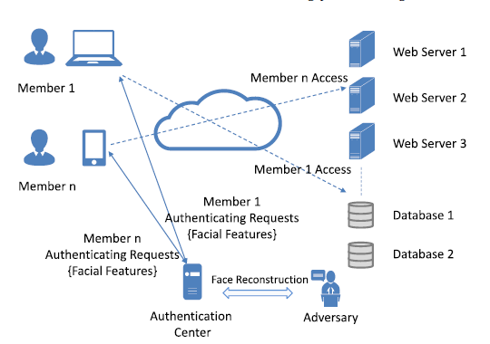
Introduction of Attack Scenario
----------------------System-----------------------
A vulnerable authentication system using facial recognition model to manage access permissions
Members need to send their facial image features in order to be authenticated
Server using a trained machine learning classifier to classify members and issue corresponding permissions
------------------------Problem--------------------------
A curious attacker might have access to the data
Reconstruct raw images to infer members’ identities
------------------Defense Motivation---------------
Prevent raw data reconstruction
Preserve meaningful features for ML use
Fig. 1. Scenario

Slide 7
Related Works
To avoid exposing plain-text data
Perturbation
Perturb Images (e.g., Generative Adversarial Privacy)
Compressive Privacy
Compress images to protect original images (e.g., PCA)
Differential Privacy (DP)
Adding noise to data in order to prevent inference attack
DP is not designed for our scenario -> still interested in seeing if it is applicable
Homomorphic Encryption
Enable ML to evaluate encrypted data without decryption
Need to design specific machine learning algorithms -> limited because it is computationally expensive
Fig. 1. Scenario

Slide 8
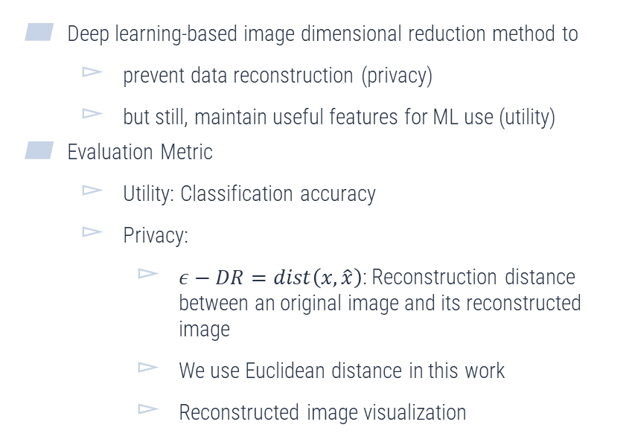
Methodology Motivation & Evaluation Metric
Deep learning-based image dimensional reduction method to
prevent data reconstruction (privacy)
but still, maintain useful features for ML use (utility)
Evaluation Metric
Utility: Classification accuracy
Privacy:
$ε−DR=dist\left(x,\hat{x}\right)$: Reconstruction distance between an original image and its reconstructed image
We use Euclidean distance in this work
Reconstructed image visualization
Fig. 2. DR projection and reconstruction

Slide 9
Methodology AutoGAN-based Dimensional Reduction for Privacy Preservation
Deep learning framework to transform images to lower dimension data including 4 deep neural network components
Generator: transform images to lower dimension data
Reconstructor: Reconstruct the raw images
Classifier: classify image (utility)
Discriminator: discriminate the reconstructed images with a target distribution (e.g., Gaussian)
Optimization problem
Fig. 3. AutoGAN-DRP

Slide 10
Methodology AutoGAN-based Dimensional Reduction for Privacy Preservation
Optimization problem
where
Fig. 3. AutoGAN-DRP

Slide 11
Experiments on AT&T , YaleB and CelebA
Accuracies increase when Dims increase
VGG19 achieves the best ACC for all datasets
Our model still preserves meaningful information of data
Fig. 4. Acc vs No of Dims for different settings

Slide 12

































Experiments on AT&T , YaleB and CelebA
Acc
0.93
AT&T
YaleB
CelebA
Dist
0.79
0.65
0.90
0.80
0.69
0.73
0.66
0.59
0.0116 0.0198 0.0245
0.0184 0.0246 0.0585
0.0513 0.0531 0.06618
Visually, images cannot be reconstructed clearly
AutoGAN-DRP
Acc
Org
(7)
(7)
(7)
Org
(7)
(7)
(7)
Org
(7)
(7)
(7)
Dist
0.69
0.63
0.57
0.68
0.60
0.58
0.62
0.59
0.56
0.0164 0.0313 0.0405
0.0149 0.0314 0.0407
0.0200 0.0418 0.0509
Differential Privacy
Acc
Org
(11)
(8)
(7)
Org
(11)
(8)
(7)
Org
(11)
(8)
(7)
Dist
0.90
0.75
0.60
0.87
0.83
0.71
0.71
0.68
0.57
0.0197 0.0264 0.0348
0.0228 0.0266 0.0287
0.0362 0.0379 0.0511
PCA
Org (15) (7) (5) Org (15) (7) (5) Org (15) (7)
Acc : Average accuracy on testing data
Dist: Average Euclidean distance between original images and reconstructed/perturbed images Org : Original images
(.) Experiment parameters: epsilon for DP and number of reduced dimensions for PCA and AutoGAN-DRP
(5)
Fig. 5. Sample visualization of different methods on three datasets

Slide 13
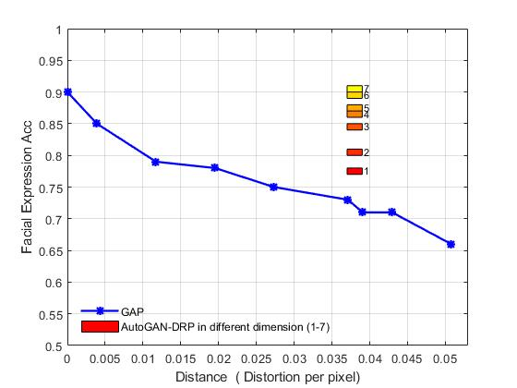
Experiments Comparison to Generative Adversarial Privacy (GAP)
Fig. 6. AutoGAN-DRP vs GAP Explanation
Fig. 7. AutoGAN-DRP vs GAP comparison (acc and distance)
On Facial Expression Dataset
We achieve better accuracy for DR from 1-7 at the reconstruction distance of 0.04

Slide 14
Conclusion
We propose a deep learning framework for image dimensional reduction which:
Preserves meaningful features for machine learning applications
Alleviates image reconstruction

Slide 15
Synthetic Information towards Maximum Posterior Ratio for deep learning on imbalanced data (SIMPOR)

Slide 16
AGENDA
Introduction
Related works
Motivation
Methodology
Synthetic Information towards Maximum Posterior Ratio (SIMPOR)
Experiments
Conclusion

Slide 17
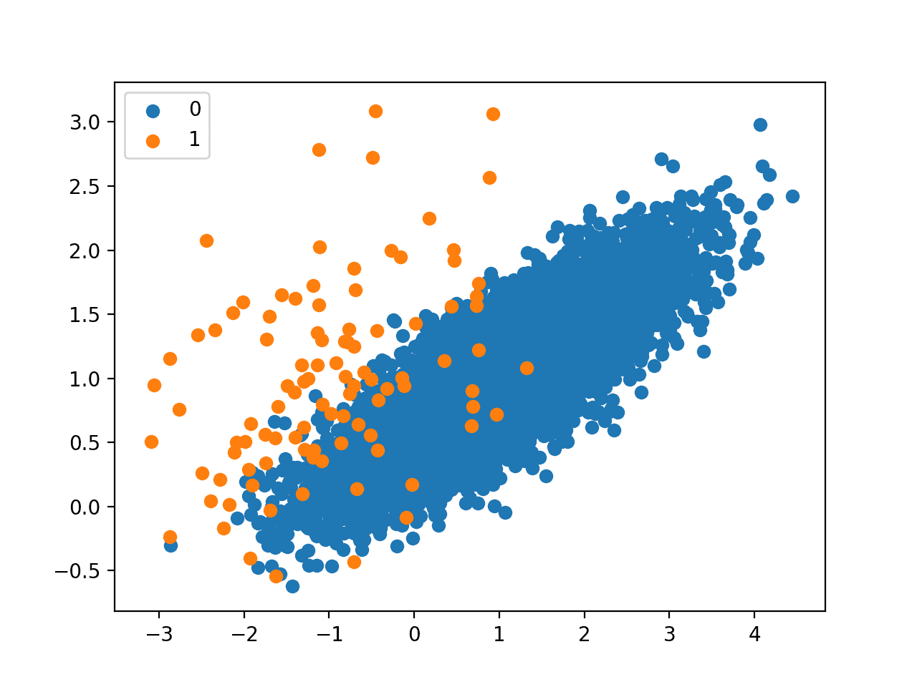
Introduction
In practice, it is common that datasets contain more samples in some classes but significantly fewer samples in others.
Medical diagnosis
Fraud detection
Facial recognition
Many reasons
Sampling procedure
Difficulty to access data
Nature of data
The problem of learning from imbalanced data
Machine learning models are dominated by the majority class
Thus, their performance might be reduced
Lack of research for deep learning models -> our focus
Fig. 8: Learning from imbalanced dataset

Slide 18
Related Works
Oversampling the minority class: (generate more samples for the minority class)
Generate synthetic data within minority classes (e.g., SMOTE [1])
It doesn’t work well for high dimensional data due to breaking data topology.
Resample minority class
Samples in the minority will be duplicated; consequently, it could cause overfitting.
Under-sampling the majority class: (simplify majority class)
Sample the majority class randomly, in order it to be balanced with the minority class.
Losing information because of losing a part of the data.
Cost-sensitive learning: (put weights on minority samples)
Assign weights to the classes or samples during the training
Overfitting on high weighted samples
[1] Chawla, N. V., et al. “SMOTE: Synthetic Minority Over-Sampling Technique.” Journal of Artificial Intelligence Research, vol. 16, June 2002, pp. 321–57. DOI.org (Crossref)

Slide 19
Motivation
This motivated us to design a data balancing technique by generating synthetic data for the minority class such that:
It reduces the negative effect of data domination
Our priority is to balance the region that affects the classifier the most
It does not to break the data topology
Avoids overfitting problem
Keeps all possible information
Expected decision
boundary
Fig. 9. Classification on Imbalanced dataset

Slide 20
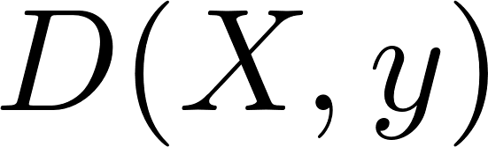
Methodology Which region affects our model the most?
Consider binary classification problem on an imbalanced dataset
2 classes, A is the majority, B is the minority
Imbalanced decision boundary
A
B
Expected decision
boundary
Fig. 9. Classification on Imbalanced dataset

Slide 21
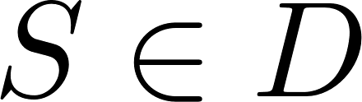
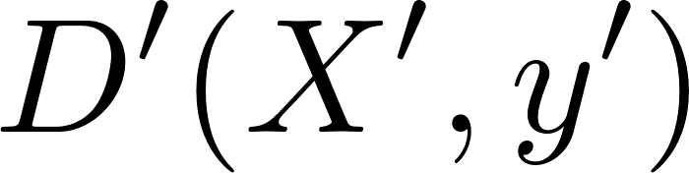
Methodology Which region affects our model the most?
Consider binary classification problem on an imbalanced dataset
2 classes, A is the majority, B is the minority
The region that affects machine learning models the most
Utilize Entropy-based active learning to find a subset of informative samples:
The remaining region will be balanced later
Result in a balanced dataset :
Imbalanced decision boundary
A
B
Expected decision
boundary
Informative Region
Fig. 10. Finding Informative Region

Slide 22
Methodology Which region affects our model the most?
Consider binary classification problem on an imbalanced dataset
2 classes, A is the majority, B is the minority
The region that affects machine learning models the most
Utilize Entropy-based active learning to find a subset of informative samples:
The remaining region will be balanced later
Result in a balanced dataset :
How to generate synthetic samples?
Imbalanced decision boundary
A
B
Expected decision
boundary
Informative Region
Fig. 10. Finding informative Region

Slide 23
Methodology How to generate synthetic data?
A simple way to balance this region and maintain data topology:
resampling minority samples (duplicate samples)
but overfitting
Imbalanced decision boundary
A
B
Expected decision
boundary
Informative Region
Fig. 11. Resampling minority samples

Slide 24
Methodology (SIMPOR) How to generate synthetic data?
A simple way to balance this region and keep data topology:
resampling minority samples (duplicate samples)
but overfitting
Imbalanced decision boundary
A
B
Expected decision
boundary
Informative Region
Fig. 11. Resampling minority samples

Slide 25
Methodology (SIMPOR) How to generate synthetic data?
A simple way to balance this region and keep data topology:
resampling minority samples (duplicate samples)
but overfitting
Imbalanced decision boundary
A
B
Expected decision
boundary
Informative Region
Fig. 11. Resampling minority samples

Slide 26
Methodology (SIMPOR) How to generate synthetic data?
A simple way to balance this region and keep the data topology:
resampling minority samples (duplicate samples)
but overfitting
Imbalanced decision boundary
A
B
Expected decision
boundary
Informative Region
Fig. 11. Resampling minority samples

Slide 27
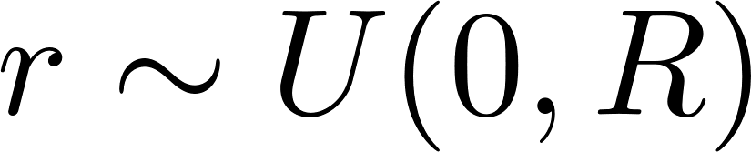
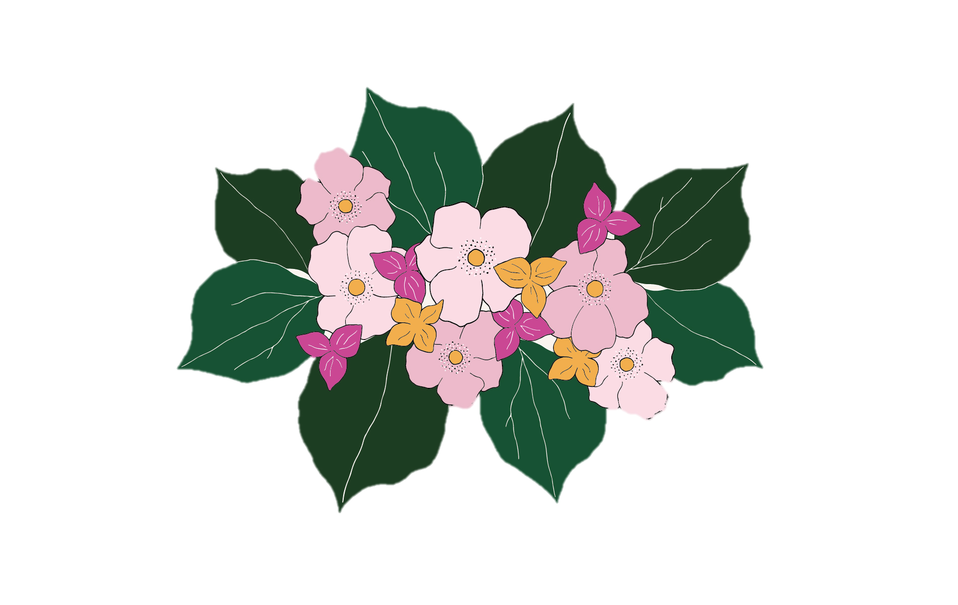


Methodology (SIMPOR) How to generate synthetic data?
A simple way to balance this region and keep data topology:
resampling minority samples (duplicate samples)
but overfitting
Avoid the overfitting problems, preserve data topology
Safely generate neighbors surrounding minority samples
Sphere within a small radius
Direction
A
B
$$\vec{v}$$
$$r$$
$$\vec{v}$$
Informative Region
Flower’s petal
(Synthetic samples)
Fig. 12. Generate synthetic samples for minority class
Flower’s stigma
(Minority sample)
Simpor Flowers

Slide 28
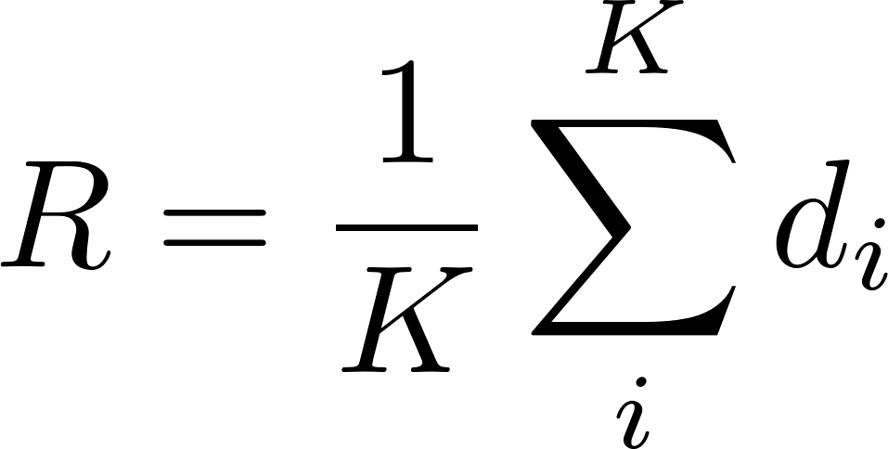



Methodology (SIMPOR) How to determine R?
A simple way to balance this region and keep data topology:
resampling minority samples (duplicate samples)
but overfitting
Avoid the overfitting problems, preserve data topology
Safely generate neighbors surrounding minority samples
Sphere within a small radius
To determine R:
Average distance of the K-nearest neighbors to x
A
B
$$d_{1}$$
$$d_{2}$$
$$r$$
$$d_{3}$$
Informative Region
$$1/R$$
Fig. 13. Determine R
$$0$$
$$r$$
$$R$$
Fig. 14. r is sampled from a uniform distribution

Slide 29


Methodology (SIMPOR) How to determine direction $\vec{v}$ ?
A simple way to balance this region and keep data topology:
resampling minority samples (duplicate samples)
but overfitting
Avoid the overfitting problems, preserve data topology
Safely generate neighbors surrounding minority samples
Sphere within a small radius
Direction
However, generating synthetic data in the informative region is critical.
If the synthetic data fall into majority -> Create errors in the decision boundary -> ML model performs poorly
A
B
$$\vec{v}$$
$$r$$
$$\vec{v}$$
Informative Region
Fig. 15. Determine direction to generate synthetic samples

Slide 30




Methodology (SIMPOR) How to determine direction $\vec{v}$ ?
A simple way to balance this region and keep data topology:
resampling minority samples (duplicate samples)
but overfitting
Avoid the overfitting problems, preserve data topology
Safely generate neighbors surrounding minority samples
Sphere within a small radius
Direction
However, generating synthetic data in the informative region is critical.
If the synthetic data fall into A -> Create errors in the decision boundary -> ML model performs poorly
What direction to ensure synthetic samples falling into B?
A
B
$$\vec{v}$$
$$r$$
$$\vec{v}$$
Informative Region
Fig. 15. Determine direction to generate synthetic samples

Slide 31
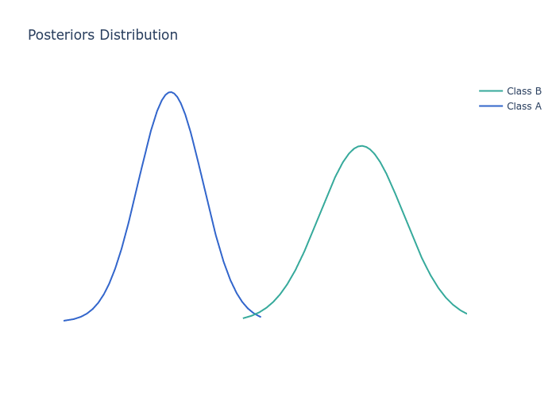
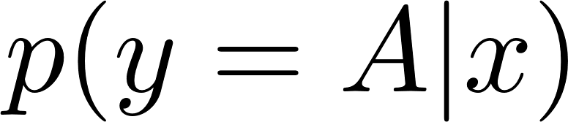
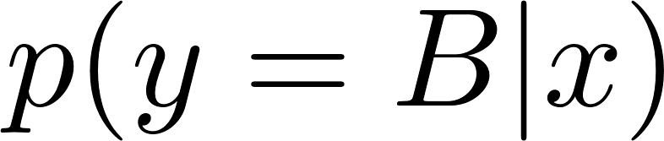
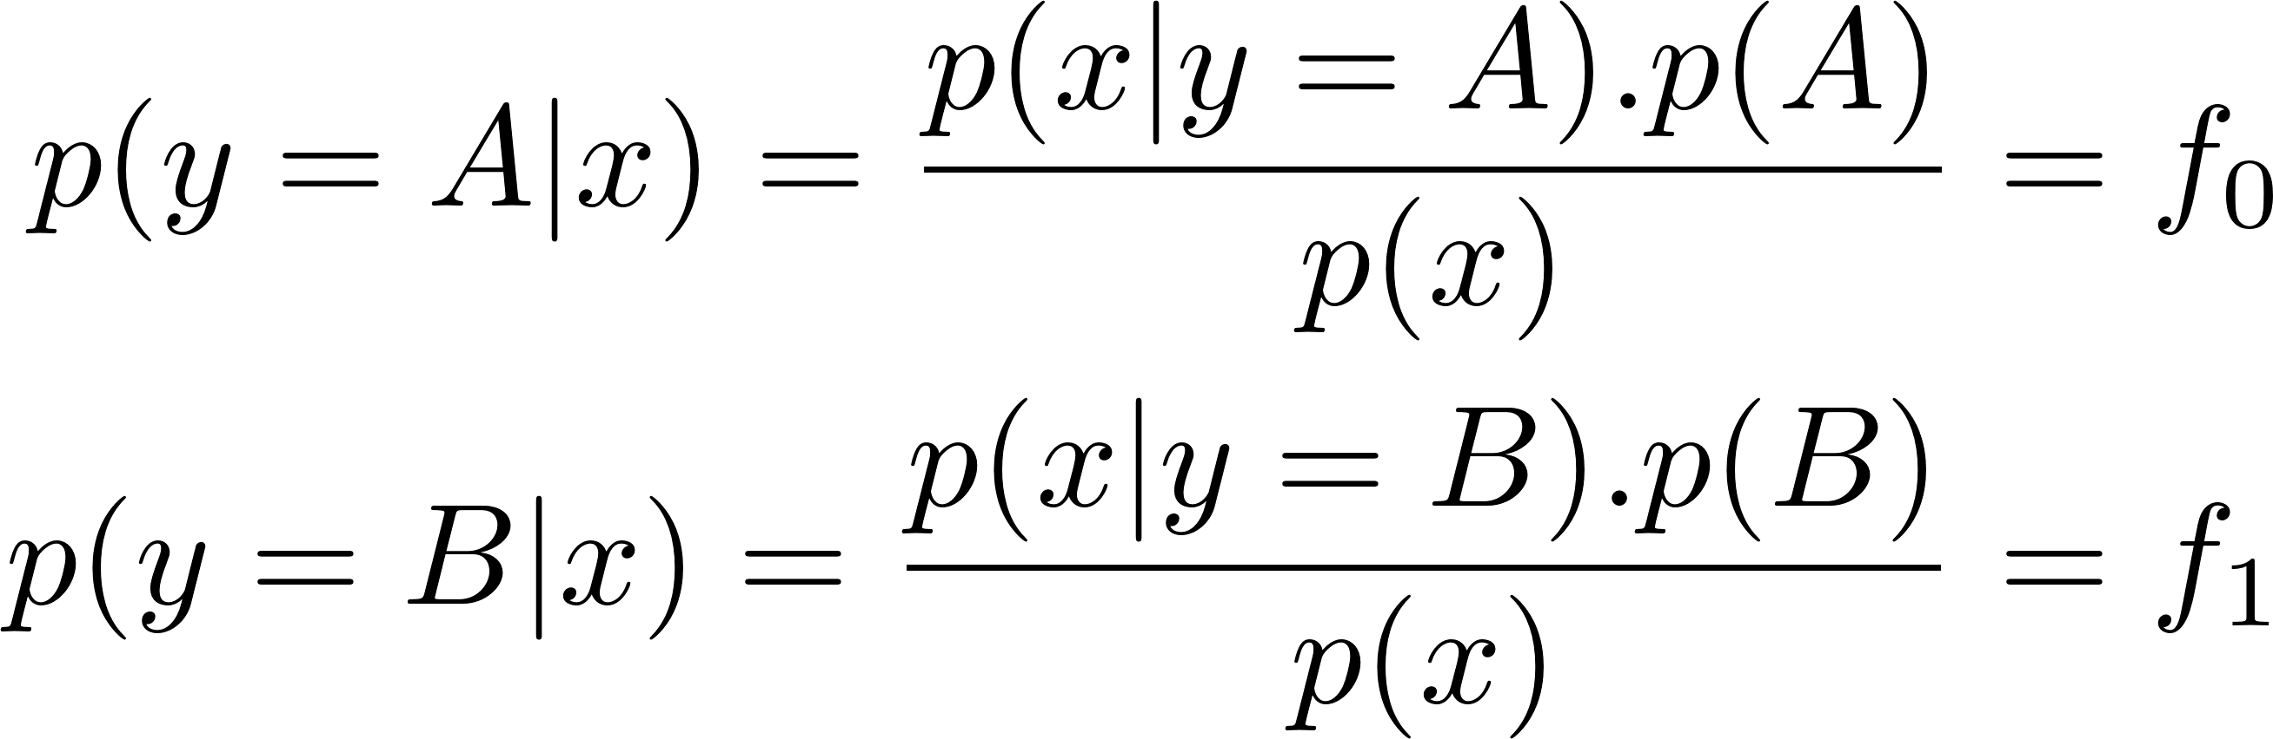
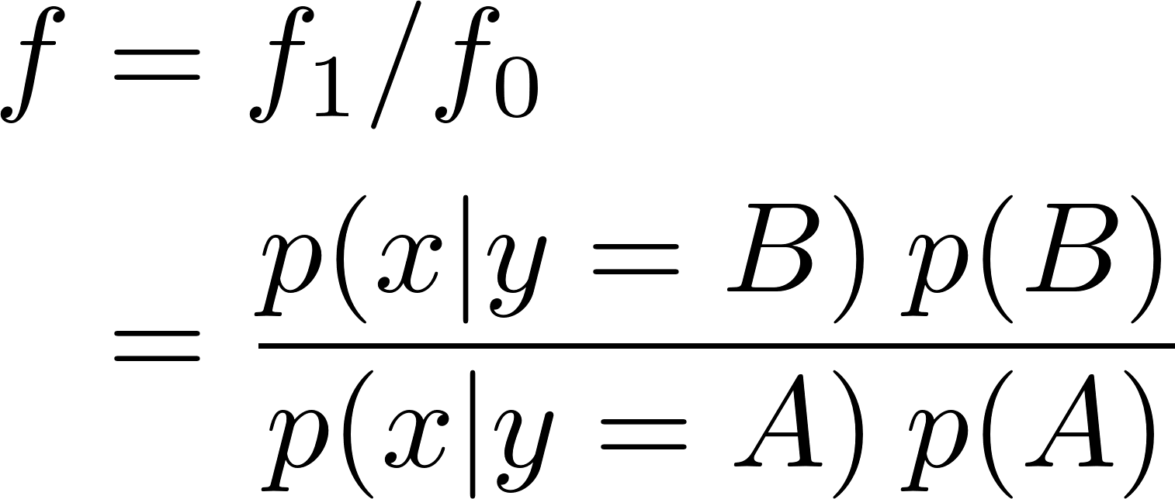
Methodology (SIMPOR) How to determine direction $\vec{v}$ ?
Increase the probability that the synthetic samples fall into the minority class and far from the majority class
Consider 2 posteriors (Bayes’ rule):
Maximize Posterior Ratio
Close to class B, far from class A
A
B
$$\vec{v}$$
$$r$$
Informative Region
Fig. 16. Maximize Posterior Ratio

Slide 32
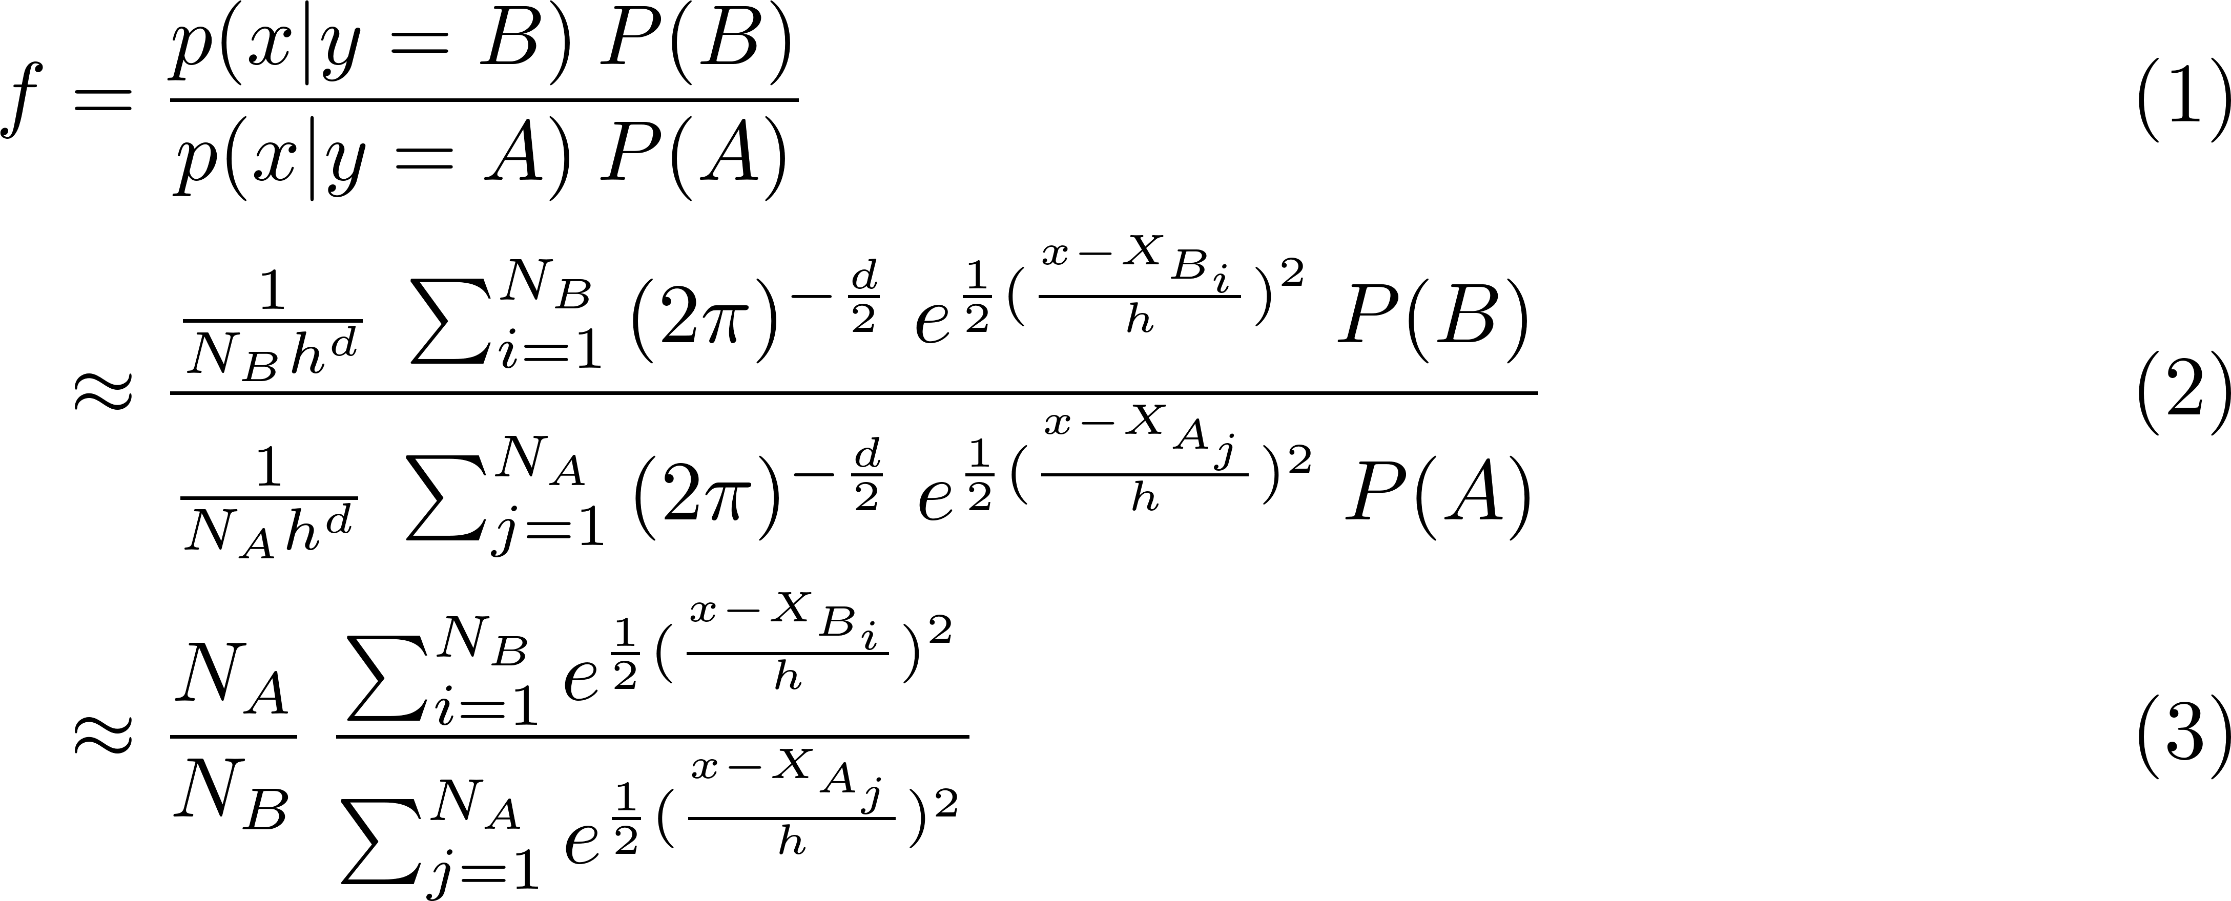
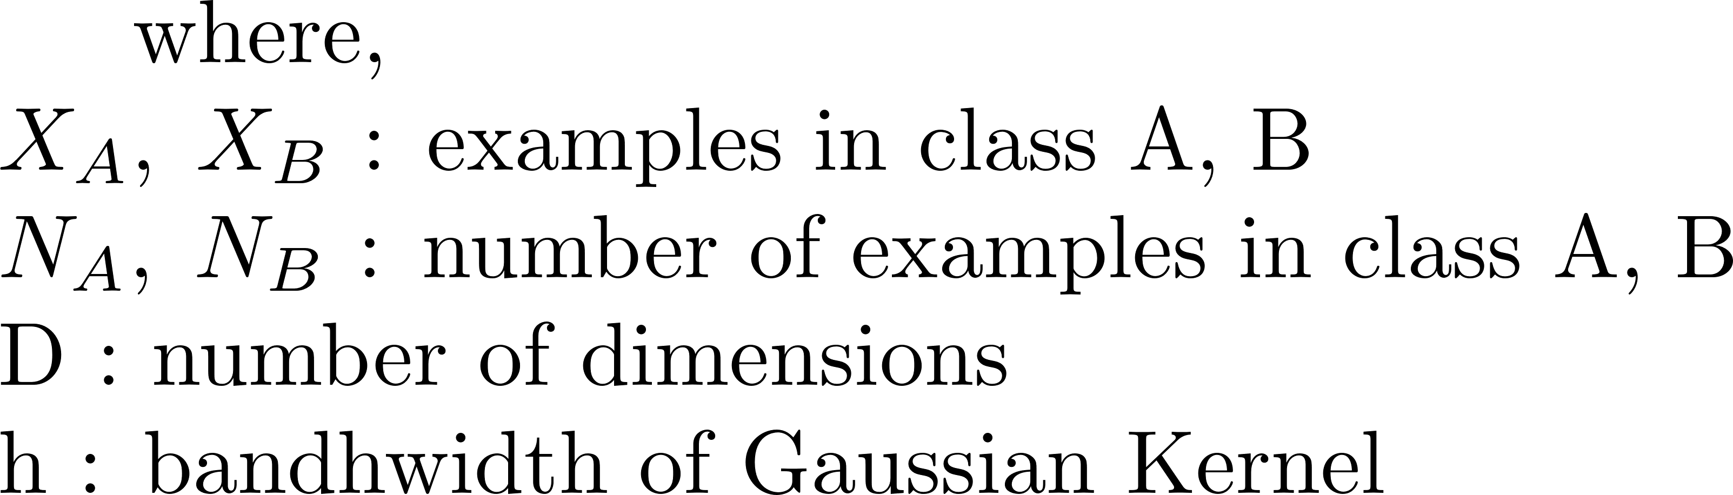
Methodology (SIMPOR) How to determine direction $\vec{v}$ ?
Maximize Posterior Ratio
We assume the priors P(A) & P(B) are constants
Use Gaussian Kernel Density Estimation (GKDE) for approximating the likelihoods
Don’t need assumption for data distribution (Non-parametric)
Work with complex distribution of data

Slide 33
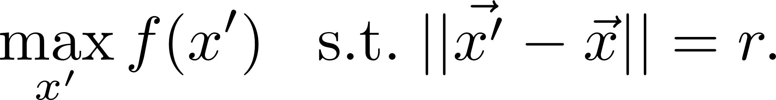
Methodology (SIMPOR) How to generate synthetic minority samples?
Generate a neighbor x’ surrounding a minority sample x within a radius r and maximize posterior ratio f(x’),
We solve the following constrained optimization problem for each minority sample :
This can be solved!
Using Projected Gradient Ascent to find maximum x’
To enrich synthetic data, we accept local and global minimum
x’ is the synthetic sample
Repeated until the entire data are balanced
Fig. 17. Maximize Posterior Ratio

Slide 34

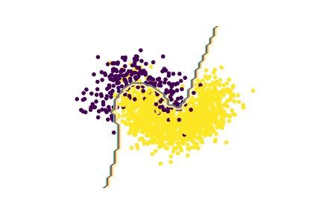
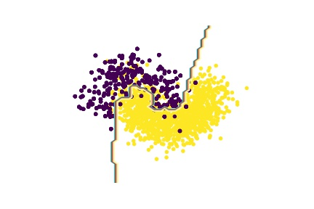
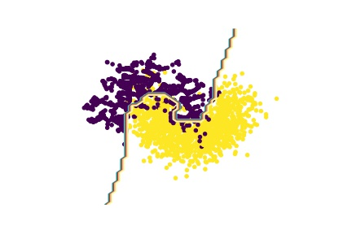

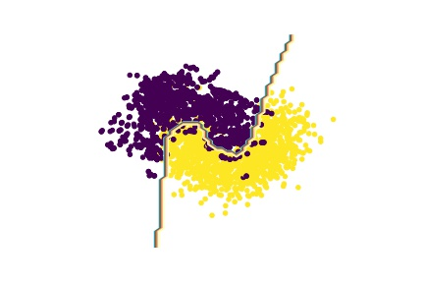
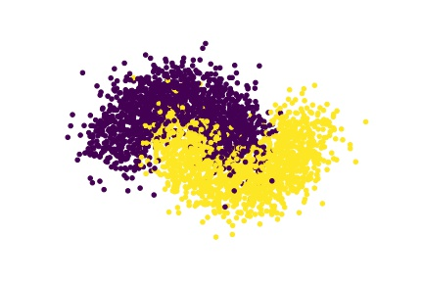
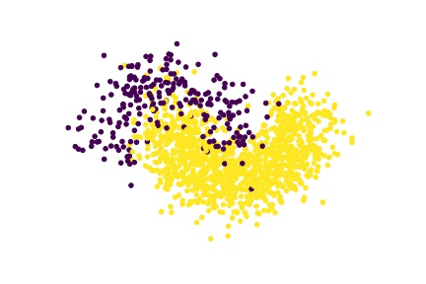
Experiments and discussion
Synthetic 2-dimension data: Two Moons Dataset
Original Data: {1: 500, 0: 500}
Create artificial imbalanced data by randomly removing some samples in class 0 (500:160)
Imbalance Ratio 3:1
Split 75% for training, 25% testing
Classifier Deep Fully Connected Neural Network:
2 hidden layers
300 neurons each layer
Without balancing
F1: 0.8936
Resampling (duplicating samples)
F1: 0.9040
SMOTE
F1: 0.9089
SIMPOR (informative region balance)
F1: 0.9169
SIMPOR
F1: 0.9170
Fig. 18. Original Moon
Fig. 19. Artificial imbalanced Moon
Fig. 20. Classification results

Slide 35
Experiments and discussion
Breast Caner Dataset
Randomly remove some samples to make Imbalance Ratio 3:1
2 classes: 300 Negative and 100 Positive
32 features
Split 75% for training and 25% for testing
10 runs
Credit Card Fraud Dataset
Randomly remove some to make Imbalance Ratio 3:1
2 classes: 1430 Negative and 490 Positive
30 features
Split 75% for training and 25% for testing
10 runs
Original | Resampling | SMOTE | SIMPOR
0.9748 ± 0.008 | 0.9729 ± 0.004 | 0.9835 ± 0.010 | 0.9877 ± 0.005
Original | Resampling | SMOTE | SIMPOR
0.9006 ± 0.008 | 0.9138 ± 0.005 | 0.9100 ± 0.010 | 0.9157 ± 0.009
Table 1. F1 Score over different technique
Table 2. F1 Score over different technique

Slide 36
Conclusion
Proposed data balancing technique:
Generate synthetic data for minority class towards maximum the posterior ratio
Prioritize to imbalance the region affecting deep learning models the most by leveraging entropy-based active learning
Reduce overfitting problem in deep learning and preserve data topology
Ensure the synthetic data fall into the expected class by maximizing the posterior ratio

Slide 37
Future Work
Generating neighbors for minority samples can enrich the quantity of data.
However, for visualizable dataset such as images, the synthetic neighbors will look like noisy versions of original images.
We would like to improve our technique to generate meaningful synthetic data for imbalanced image dataset

